Slide 1
2. Inter-Process Communication II
Remote procedure call (RPC) (continued)
Remote (object) method invocation (RMI)

Slide 2
RPC: Implementation
The software that supports RPC has three main tasks:
  Interface processing: integrate the RPC mechanism with client and server programs in conventional programming languages.
  Communication handling: transmitting and receiving request and reply messages.
  Binding: locating an appropriate server for a particular service.

Slide 3
RPC: Implementation
Interface Processing: An interface definition may be used as basis on which to construct the extra software components of the client and server programs enabling RPC.
* Building the client program: An RPC system provides a means to build a complete client program by having sub procedure to stand in for each RPC.
* Building the server program: An RPC system provides a dispatcher and set of server sub procedures.
* An interface compiler in an RPC system processes interface definitions to produce components that can be combined with client and server programs:
  Generating a client stub procedure: The sub procedures will be compiled and linked with client program.

Slide 4
RPC: Implementation
  Generating a server stub procedure, the dispatcher and the server stub will be compiled and linked with the server program;
  Use the signatures of the procedures in the interface to generate marshalling and unmarshalling operations in each stub procedure;
  Generating procedure headings for each procedure in the service from the interface definition;
Communication handling: the module in both client and server programs is to deal with communication between them (generally using request-reply). The module is provided in forms suitable for linking with client and server programs.

Slide 5
RPC: Implementation (in C, Unix)
Binding
  It specifies a mapping from a name to a particular object usually identified by a communication ID (e.g., server port).
  An interface definition specifies a textual service name for use by clients and servers. Clients that request the service (specified by service name) must send the request message to the server port binding to the service.

Slide 6
RPC: Implementation
  Binder: a separate service that maintains a table containing mappings from service names to server ports.
  All other services depend on the binder service.
  Binder interface used by server
    Register (String serviceName, Port serverPort, int version)
    Withdraw (String serviceName, Port serverPort, int version)
  Binder interface used by client
    PortLookUp (String serviceName, int version)

Slide 7
Case Studies: SUN RPC (in C, Unix)
Interface definition language: XDR
  a standard way of encoding data in a portable fashion between different systems, it is extended to become an interface definition language (IDL);
Interface compiler: rpcgen
  A compiler that takes the definition of a remote procedure interface, and generates the client stubs and the server stubs;
Communication handling: TCP or UDP
Version: RPCSRC 3.9 (4.3BSD UNIX)
  A run-time library to handle all the details.

Slide 8
Case Studies: SUN RPC
Simple example: the client calls using RPC and the server have the following two functions:
  bin_date_1 returns the current time as the number of seconds since 00:00:00 GMT, January 1, 1970.
  str_date_1 takes a long integer value from the previous function and converts it into an ASCII string that is fit for human consumption.

Slide 9
Case Studies: SUN RPC
server procedure
server program
date_proc.c
CC
date_svc
server stub
date_svc.c
RPC specification file
RPC
run-time
library
date.x
rpcgen
date.h
date_clnt.c
client main function
client program
client stub
rdate.c
CC
rdate

Slide 10
Case Studies: SUN RPC
To build the remote procedure call rdate (executable client program), write the server procedure (data_proc.c), client main function (rdate.c), and RPC specification file (date.x). Then compile the files:
* Generate the executable server program:
cc -o date_svc date_proc.c date_svc.c -lrpclib
* Generate the executable client program:
cc -o rdate rdate.c date_clnt.c -lrpclib
The date_svc.c (server stub), data_clnt.s (client stub), and date.h that is used in stub procedures, are the outputs of the interface compiler rpcgen.

Slide 11
Case Studies: SUN RPC
date.x
program DATE_PROG {
version DATE_VERS {
long BIN_DATE(void) = 1; /* procedure number = 1 */
string STR_DATE(long) = 2; /* procedure number = 2 */
} = 1; /* version number = 1 */
} = 0x31234567; /* program number = … */
  0x20000000 - 0x3fffffff is defined by user;

Slide 12
Case Studies: SUN RPC
date.h
#define DATE_PROG ((u_long) 0x31234567)
#define DATE_VERS ((u_long) 1)
#define BIN_DATE ((u_long) 1)
extern long *bin_date_1( );
#define STR_DATE ((u_long) 2)
extern char **str_date_1( );

Slide 13
Case Studies: SUN RPC
rdate.c
/* client program for remote date service. */
#include <stdio.h>
#include <rpc/rpc.h> /* standard RPC include file */
#include “date.h” /* generated by rpcgen */
main(argc, argv)
int argc;
char *argv[];

Slide 14
Case Studies: SUN RPC
{ CLIENT *cl; /* RPC handle */
char *server;
long *lresult; /* return value from bin_date_1 */
char **sresult; /* return value from str_date_1 */
if (argc != 2) {
fprintf(stderr, “usage: %s hostname\n”, argv[0]);
exit(1);
}
server = argv[1];

Slide 15
Case Studies: SUN RPC
/* create the client handle */
if ((cl = clnt_create(server, DATE_PROG, DATE_VERS, “udp”))
== NULL) {
/* couldn’t establish connection with server */
clnt_pcreateerror(server); exit(2);
}
/* first call the remote procedure “bin_date” */
if ((lresult = bin_date_1(NULL, cl)) == NULL) {
clnt_perror(cl, server); exit(3);
}
printf(“time on host %s = %ld\n”, server, *lresult);

Slide 16
Case Studies: SUN RPC
/* now call the remote procedure “str_date” */
if ((sresult = str_date_1(lresult, cl)) == NULL) {
clnt_perror(cl, server); exit(4);
}
printf(“time on host %s = %s\n”, server, *sresult);
clnt_destroy(cl); /* done with the handle */
exit(0);
}

Slide 17
Case Studies: SUN RPC
date_proc.c
/* remote procedure; called by server stub */
#include <rpc/rpc.h> /* standard RPC include file */
#include “date.h” /* generated by rpcgen */
/* return the binary date and time */
long *bin_date_1( )
{
static long timeval; /* must be static */
long time( ); /* UNIX function */

Slide 18
Case Studies: SUN RPC
timeval = time((long *) 0);
return(&timeval);
}
/* convert a binary time and return a human readable string */
char **str_date_1(long *bintime)
{
static long *ptr; /* must be static */
char *ctime(); /* UNIX function */
ptr = ctime(bintime); /* convert to local time */
return(&ptr); /* return the address of pointer */
}

Slide 19
Case Studies: SUN RPC
clnt_create: create an RPC handle (including socket for communication) to the specified program and version on specified server host;
bin_date_1(NULL, cl): the client stub procedure given in definition BIN_DATE;
str_date_1(lresult, cl): the client stub procedure given in definition STR_DATE;
The client stub (bin_date_1 or str_date_1) calls procedure clnt-call (not shown) to make an RPC call to a server.
static variable: The variable for return value must be static. If we did not use static variables, their values would be undefined after return statement passes control back to the server stub that calls our remote procedure.

Slide 20
Case Studies: SUN RPC
The binding in SUN RPC (as shown in the next slide):
1. The server program calls a function in the RPC library, svc_register, register its program number and version to the remote system.
This function contacts the port mapper process to register itself.
2. The client program calls clnt_create to contact the port mapper to find out the UDP port for the server.
3. Call bin_date_1 remote function and receive its return value.
4. Call str_date_1 remote function and receive its return value.

Slide 21
Case Studies: SUN RPC
Steps involved in binding and usage in RPC calls:
portmapper
daemon
1
date_svc
(server)
Remote
system
3
2
4
rdate
(client)

Slide 22
Extended RPC Models
RPC has become a de facto standard for communication in DSs due to its apparent simplicity. Some models from RPC extensions have been proposed.
Making use of the local IPC facilities: The original RPC model assume that the caller and callee communicate by message passing over a network. If both of them are on the same machine, more efficient local IPC mechanisms can be used.
Asynchronous RPC: In conventional RPC, when a client calls a remote procedure, the client will block until a reply is returned (using synchronous transient communication). RPC may provide facilities, called asynchronous RPC, by which a client immediately continues after issuing the RPC request.

Slide 23
Distributed Object and RMI
In object-based distributed systems, the communication between distributed objects is mainly done by means of RMI.
Remote method invocation (RMI): Method invocation between objects in different processes that may be in the same or different computers. An RMI is similar to RPC but it is specific for distributed object.
The design issues: invocation (call) semantics of RMI, and the level of transparency in RMI.
Implementation: A layer of middleware (like RPC) above the request-reply protocol may be designed to support RMI between application-level distributed objects.

Slide 24
Remote Method Invocation: Object Model
An object-oriented program (e.g., Java or C++) consists of a collection of interacting objects. An object communicates with other objects by invoking their methods, usually passing arguments and receiving result.
Interface: a definition of the signatures of a set of methods (method names, their arguments, return values and exceptions) without specifying their implementation.
An object encapsulates date (called state), and operations (methods) on those data. Methods are made available through an interface. An object’s data can be accessible only via its methods.

Slide 25
Remote and local method invocations
remote
local
C
invocation
invocation
local
E
invocation
remote
B
invocation
F
A
local
invocation
D

Slide 26
A distributed object and its interface
remote
object
remote
Data
interface
m4
{
m1
implementation
m2
m5
m3
of methods
m6

Slide 27
RMI: Distributed Objects and Remote Objects
The separation between interfaces and objects: An object may implements multiple interfaces, and an interface may be offered an implementation by several objects.
Distributed objects: A strict separation is to place an object interface at one machine while the object (defined as distributed object) itself resides on another machine, as shown in the next slide.
Remote objects: In most distributed objects, their state is not distributed: it resides at a single machine. Only the interfaces implemented by the object (defined as remote object) are made available on another machines.

Slide 28
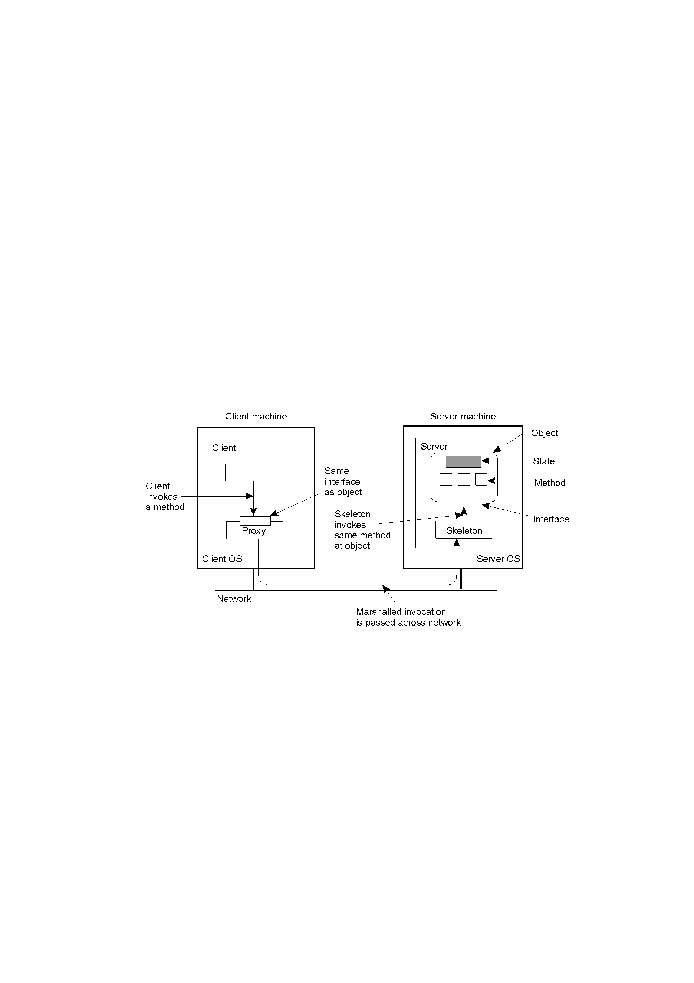
Distributed Objects
2-16
Common organization of a remote object with client-side proxy.

Slide 29
RMI: Distributed Object Systems
The distribution of objects into different processes or computers in a DS is a natural extension to become distributed object systems (DOS).
A DOS may adopt the client-server architecture. In RMI, the client’s request to invoke a method of an object is sent to server managing the object. The invocation is carried out by executing the method at the server, and the result is returned to the client.
A DOS can also assume the other architectural models. E.g., objects can be replicated or migrated to enhance performance and availability.

Slide 30
RMI: How to make an RMI?
Before invoking a method in an (remote) object, a client binds to the object by loading an implementation of the object’s interface, proxy, into the client’s address space.
Proxy (analogous to client stub in RPC): it marshals the method invocations into messages to be sent to the actual object (residing at a server machine), and then unmarchals reply message to return the result of invocation to the client.
The incoming invocation requests are passed to a server stub, analogous to the server stub in RPC, called skeleton.
Skeleton: it unmarchals the incoming invocation messages to proper method invocations at the object’s interface at server. It is also responsible for marshalling replies and forwarding reply messages to the client-side proxy.

Slide 31
RMI: Object References
A distinct difference between RPC system and RMI system is that RMI system provides system-wide object references, and such object references can be freely passed between processes in DS. Object references can be used as parameters to RMI.
When a process holds an object reference, it must first bind to the referenced object. In many cases, binding can be done automatically. When an object reference is given, it needs a way to locate the server that manages the actual object and place a proxy in the client’s address space.
An object reference must contain enough information to allow a client to bind to an object.

Slide 32
RMI: Object References
A simple object reference would include the IP address of the machine the actual object resides, the identity (endpoint) server that manages the object, and an indication of which object (provided by the server). There are some problems with this scheme (why?).
The other (better) approach is to have a location server that keeps track of the machine an object’s server is currently running. An object reference then contains the IP address of the location server, along with a system-wide identifier for the (object) server.
An object reference may also include an implementation handle, a complete implementation of a proxy dynamically loaded to client when binding to an object.

Slide 33
RMI: Parameter Passing
In object-based DS, for efficiency, references to remote objects and those to local object are often treated differently when the object references are used as parameters in RMI:
* When the reference refers to a local object (object in the same address space as the client), the referred object is copied as a whole and passed along with the RMI.
* When it refers to a remote object, the object is literally passed by reference (the reference is copied).
The side effect of RMI with an object reference as parameter is that we may copying an object. An explicit distinction between local and remote objects is made, which may violate the distribution transparency and makes it harder to write distributed applications.

Slide 34
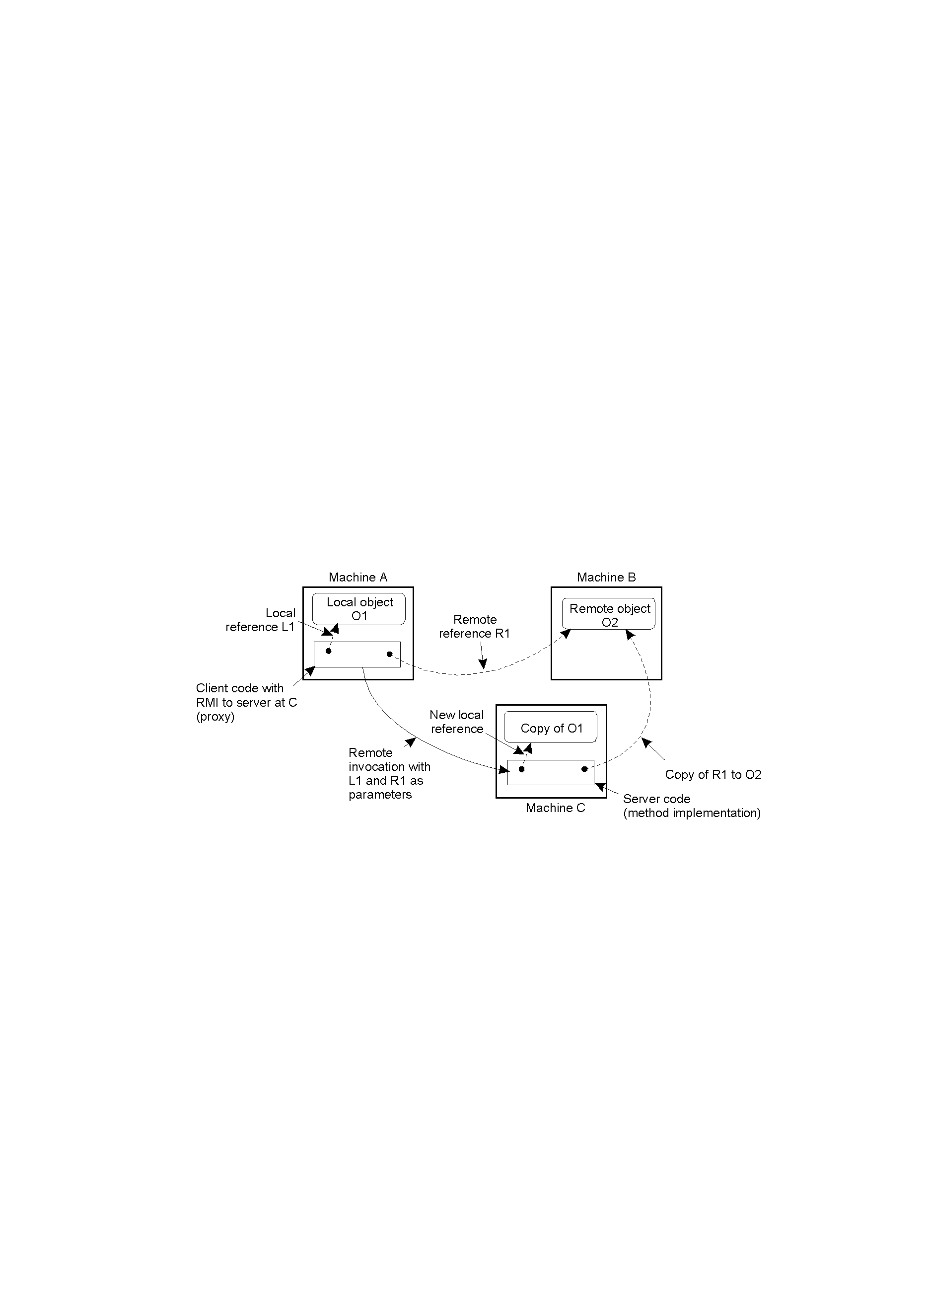
Parameter Passing
2-18
The situation when passing an object by reference or by value: An object in Machine A calls a remote method in an object in Machine C, with a local object O1 (reference L1) and remote object O2 (reference R1) on Machine B as parameters.

Slide 35
Example: Java RMI
In Java, distributed objects have been integrated into the language. It aims for high degree of distribution transparency, but also considers the performance and ease to use.
Each object in Java is an instance of a class that contains an implementation of one or more interfaces.
Java adopts remote objects (those state only resides on a single machine) as the only form of distributed objects. Interfaces are implemented by means of proxy as local object in the client’s address space.

Slide 36
Example: Java RMI
There are some important differences between remote objects and local objects in Java RMI:
* Cloning: Cloning a remote object can only be done by the server, resulting in making an exact copy of the object in server’s address space. Proxies of the cloned object are not cloned. Local object can be cloned as usual.
* Semantics of blocking a object: A method in Java can be declared as synchronized for a unique calling to the method. If two processes simultaneously call a synchronized method, only one is allowed to proceed, the other one will be blocked. In Java, it will be blocked only to the proxies, instead of at the server.

Slide 37
Remote Object Invocation in Java RMI
In parameter passing in Java RMI, local objects are passed by value while remote objects are passed by reference (as explained before).
A reference to a remote object consists of the network address, server port number, and local ID for the object used in the server’s address space, also the encoded protocol stack for communication between client and server.
A remote object is built from two different classes: class containing an implementation of server-side code (server class), and client class containing an implementation of a proxy. The server-side stub (skeleton), the client class (for proxy) are generated from the interface specifications.

Slide 38
Remote Object Invocation in Java RMI
A proxy is an object that has all the information it needs to let the client invoke methods of the remote object. In Java, proxies are serializable, that is, they can be marshaled.
In principle, most objects are serializable. Some platform-dependent objects, such as file descriptor and socket, cannot be serialized.
A proxy can be marshaled and sent (as a series of bytes) to another process, where it can be unmarshaled and used to invoke methods in the remote object.
Being able to pass proxies as parameters works only because each process is executing the same Java virtual machine (running in the same execution environment).

Slide 39
Summary I
In Implementing RPC, the software that supports RPC has three main tasks: interface processing, communication handling, and binding.
Interface definitions are required in RPC systems. Based on the interface definition, an interface compiler produces client and server stub procedures and a server dispatcher. The client making RPC uses a binder to locate a server registered with binder earlier. The calls to the binder may be supplied by the interface compiler.
The SUN RPC is an example of RPC system for use a C and UNIX environment with the required facilities.

Slide 40
Summary II
RMI in middleware provides components, such as proxies, skeletons and dispatchers, generated by an interface compiler, to hide the details of marshalling, message passing and locating remote object from client and server programmers.
An RMI is essentially an RPC, but specific for a remote object. The main difference is that RMI allows system-wide object references to be passed as parameters.
Both RPC and RMI often offer synchronous communication facilities, by which a client is blocked until the server has sent a reply, although variations of either mechanism exist to relax the synchronous feature in conventional RPC/RMI.

